Slide 1

Online
VOTING SYSTEM
Submitted by:
Name: Riya Mahawar
Course: B.Tech. CSE
Semester: 6
Section: A
Class Roll No: 51
University Roll No: 2019046
Submitted to:
Mr Pramod Mehra
Assistant Professor

Slide 2

INTRODUCTION
Traditional voting systems are the most common method of conducting elections. Although this method has been in use for centuries, it has several drawbacks such as –
1- Accessibility Issues
2- Voter Turnout
3- Efficiency
4- Cost
5- Delayed Results
6- Security concerns
7- Representation Inequities and Inequalities

Slide 3

The Online Voting System is a web-based application designed to facilitate the voting process over the internet. It leverages the modern web technologies to provide accessible, efficient and secure platform for casting votes.
protecting the integrity of the voters as well as the votes.
Key features of the Online Voting System are:
1- User Authentication
2- Secure Voting
3- Real Time Result
4- Automatic Vote Counting
Introduction &
PROBLEM STATEMENT

Slide 4


METHODOLOGY
Primary Technologies used in the Online Voting System include:
1- PHP for server-side scripting
2- Java for client-side interactivity
3- MySQL for database management
4- HTML and CSS for creating a responsive web-based application and enhancing the user interface.

Slide 5




OVERVIEW OF WORKING MODEL
VOTER AUNTHENTICATION
BALLOT
CASTING
VOTE
COUNTING
Registration: Voters must register in advance and provide personal information that will be verified.
Login: Voters utilize special credentials, like a username and password, to log in on election day.
Ballot Presentation: Following authentication, the voter is shown a digital ballot with the options or candidates listed.
Vote Selection: After making their selections, the voter's information is encrypted to protect their privacy.
Vote Submission: After the choices are verified, the vote is sent to the safe servers of the system to be tallied.
Encryption and Storage: To avoid manipulation or unwanted access, cast votes are encrypted and kept in a safe database.
Tallying: The system securely and transparently decrypts and tallies the votes, guaranteeing that every vote is precisely and only once counted.

Slide 6
OVERVIEW OF WORKING MODEL
RESULT
REPORTING
SECURITY MEASURES
AUDIT &
VERIFICATION
Result Compilation: Following the conclusion of the voting period, the system generates reports for every candidate or option.
Announcement: To ensure openness and accessibility, results are made public via the system's interface as well as other authorized means.
Access Controls: Strict access controls guarantee that only individuals with the proper authorization can access the administrative features and data of the system.
Audits: Post-election audits are carried out to confirm the accuracy of the vote total and the system's correct operation.
Voter Verification: To increase confidence in the system, some systems enable voters to confirm that their vote was tallied without disclosing their choices.

Slide 7

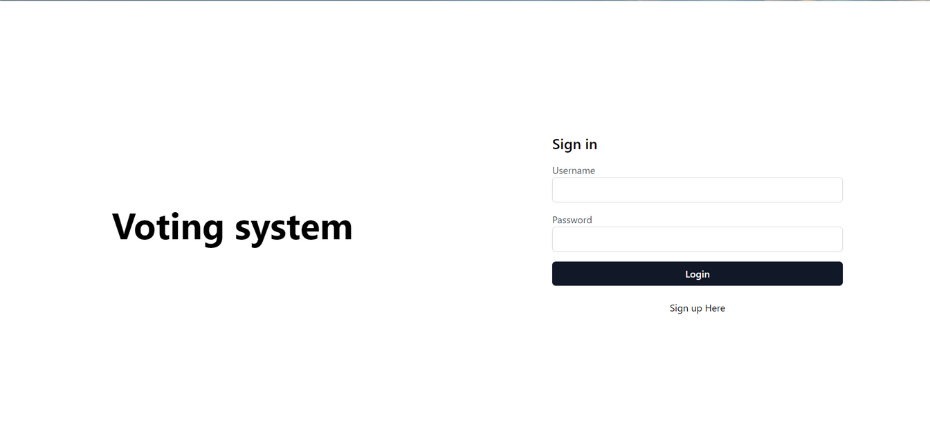
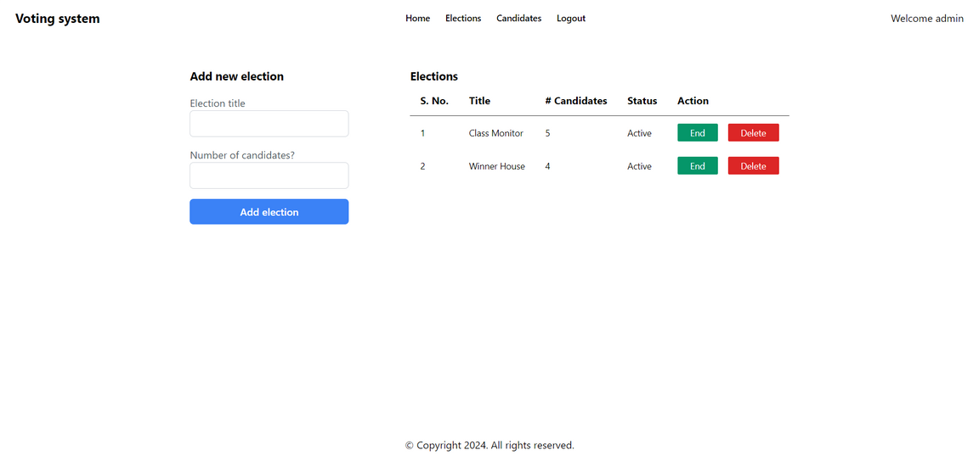
RESULT &
DISCUSSION
This project was able to successfully implement a secure and efficient online voting system, enabling the smooth conduct of elections with robust user authentication and vote management.

Slide 8
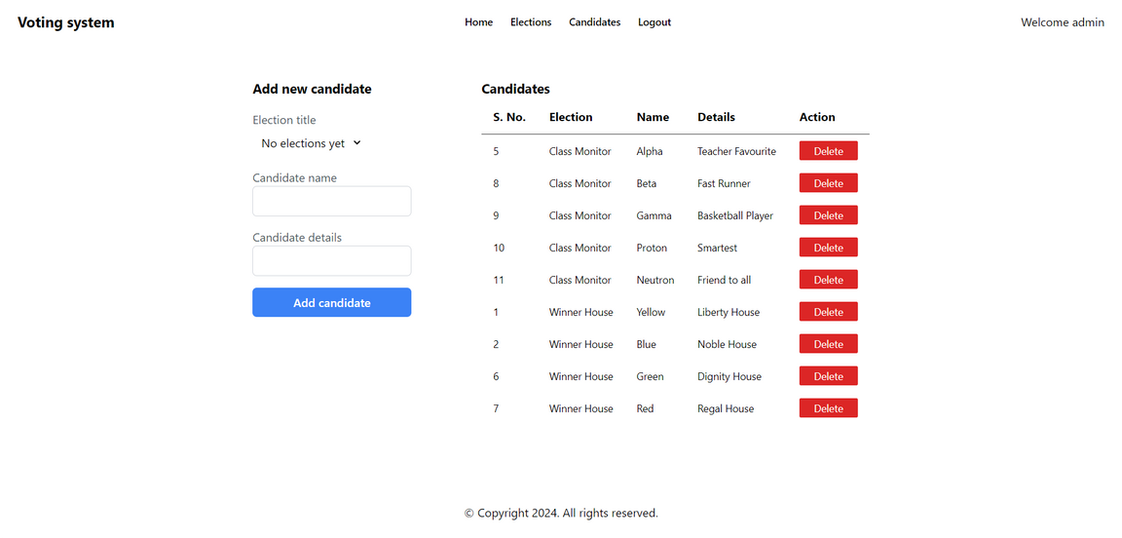
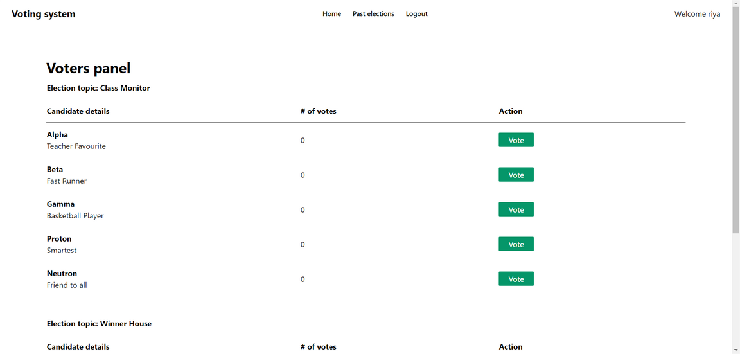
RESULT &
DISCUSSION
This project was able to successfully implement a secure and efficient online voting system, enabling the smooth conduct of elections with robust user authentication and vote management.

Slide 9

Conclusion
Future Work
CONCLUSION
FUTURE WORK
With many advantages over conventional techniques, the online voting system is a major improvement in election administration. By enabling voters to participate from anywhere, the method improves accessibility and boosts voter turnout. It also guarantees quicker and more precise vote tallying, cutting down on the amount of time needed to declare the outcome.
1. Enhanced security and transparency, it incorporates blockchain technology, biometric verification, and cutting-edge encryption techniques.
2. Scalability and Performance
3. Legal and Regulatory Framework
4. Research and Development

Slide 10
THANK YOU

